Slide 1
Validity Threats

Slide 2
Why should you bother about validity threats?
Quality
Ensure that you think of what may go wrong before you conduct the study.
It is very difficult to go back and re-do a study.
Credibility
It is difficult to show that you have addressed all validity threats in your study design. You need more room to argue.
Address possible criticism before the readers have had a chance to formulate it.

Slide 3
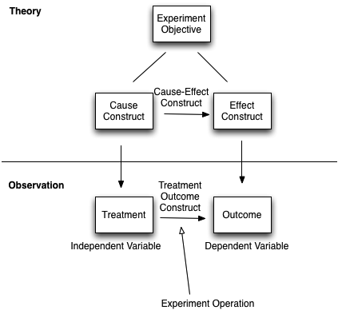
What we want to achieve
Experiment Design

Slide 4
Common Categories of Validity Threats
Conclusion Validity
Are we able to draw the correct conclusions between treatment and outcome?
Is there a statistical relationship between treatment and outcome?
Internal Validity
Can something outside of our control cause the same effect?
Construct Validity
Are we measuring the right thing?
Does our treatment reflect the cause construct?
External Validity
Can we generalise our findings?
Is the cause-effect construct context-dependent?

Slide 5
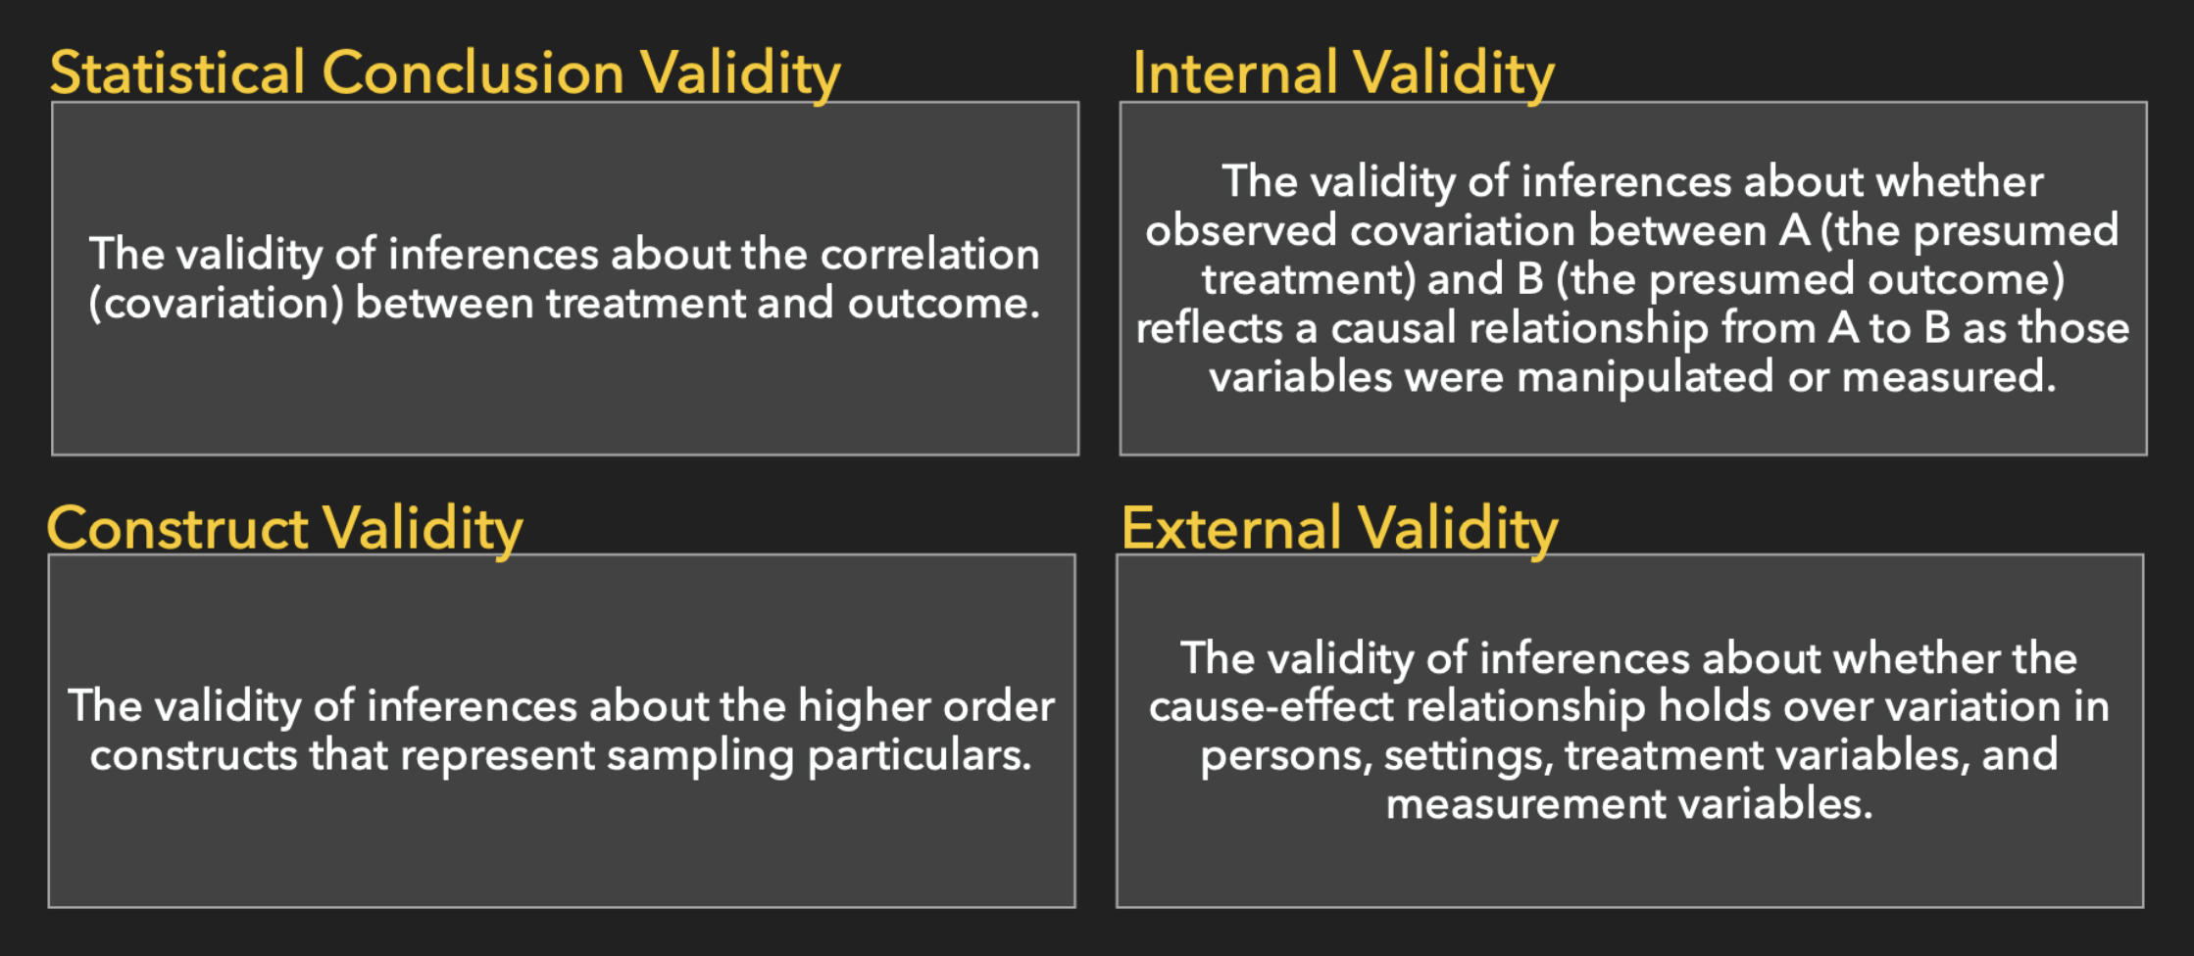
Or another picture

Slide 6
Conclusion Validity Are we able to draw the correct conclusions between treatment and outcome?

Slide 7
Internal Validity Can something outside of our control cause the same effect?

Slide 8
Construct Validity Are we measuring the right thing?

Slide 9
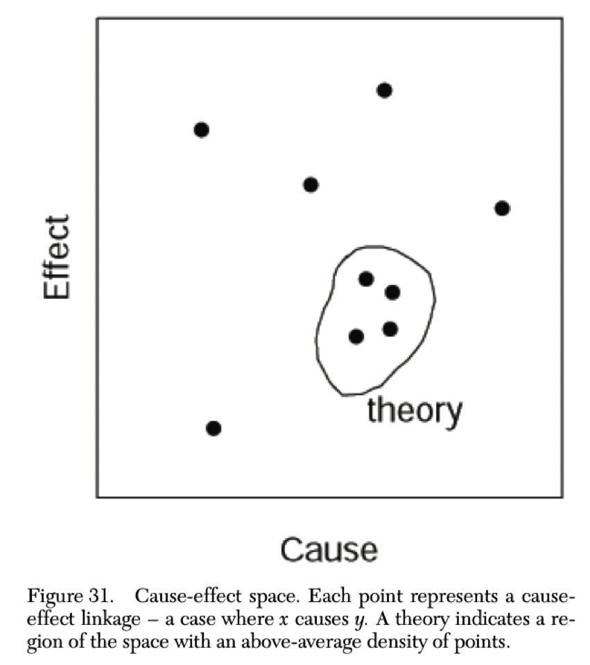

Slide 10
External Validity Is the cause-effect construct context-dependent?

Slide 11
Conclusion Validity
Low statistical power
Violated assumptions of statistical tests
Fishing and the error rate
Reliability of measures (measurement error)
Reliability of treatment implementation (if you use non-standard approaches you will often underestimate)
Random irrelevancies in experimental setting (inflates error)
Large random heterogeneity of subjects. Variation is larger due to individual diff, not treatment (within research designs)

Slide 12
Internal Validity
Single Group Threats
History (something else causes the effect)
Maturation (events that typically transpire in a life)
Testing (priming, i.e., preparing people)
Instrumentation (change in instrument; alternate forms → see survey research lecture)
Multiple Group Threats
Selection bias (groups are not comparable before study), which affects the above threats also!

Slide 13
Internal Validity
Social Threats
Diffusion or imitation of Treatment (exchange of information between the groups)
Compensatory equalisation of treatments (groups not provided the preferred treatment get compensated)
Compensatory rivalry (control group is annoyed)
Resentful Demoralisation (experimental group is annoyed)

Slide 14
Construct Validity
Design Threats
Inadequate preoperational explication of constructs (basics is wrong from start, e.g., it’s really not a treatment)
Mono-operation bias (same version of the treatment all the time, change version → IV)
Mono-method bias (use multiple measures → DV)
Confounding constructs and levels of constructs (higher dosage might give an effect…)
Interaction of different treatments (e.g., other studies interacting with your study)
Interaction of testing and treatment (does measurement itself affect the treatment?)
Restricted generalisability across constructs (yes, the treatment if effective, but has side effects)

Slide 15
Construct Validity
Social Threats
Hypothesis guessing (subjects are trying to figure out what the study is about)
Evaluation apprehension (are they performing better because they are part of the experiment or because they react to treatment?)
Researcher expectancies (conscious or unconscious)

Slide 16
External Validity
Interaction of selection and treatment
Is it also applicable to other individuals with different characteristics?
Interaction of setting and treatment
could you apply this program within a different setting and see similar results?
Interaction of testing and treatment
Would your results be the same if implemented without a pretest?
Interaction of history and treatment
Events outside of the study/experiment or between repeated measures of the dependent variable may affect participants’ responses to experimental procedures

Slide 17
Priority among threats
Addressing one type of threat may increase the risk of another.
For example:
More homogenous subjects may increase conclusion validity but decrease external validity.
Students as subjects: Able to use more subjects, good for conclusion validity, but may no longer be representative of intended population
Smaller scale problem (toy problem): easier to control (good for internal validity), but no longer a representative problem.

Slide 18
Priority among threats
Theory (testing)
Internal validity
Construct validity
Conclusion validity
Applied Research
Internal validity
External validity
Construct validity

Slide 19
Other types of studies
Case Studies
Social Threats
Conclusion validity
Internal Validity
External Validity?
Surveys
Construct Validity
Conclusion Validity
Internal Validity
Literature Surveys
Repeatable Methodology?
Construct Validity
Limitations?
External Validity
Bias?
Conclusion Validity

Slide 20
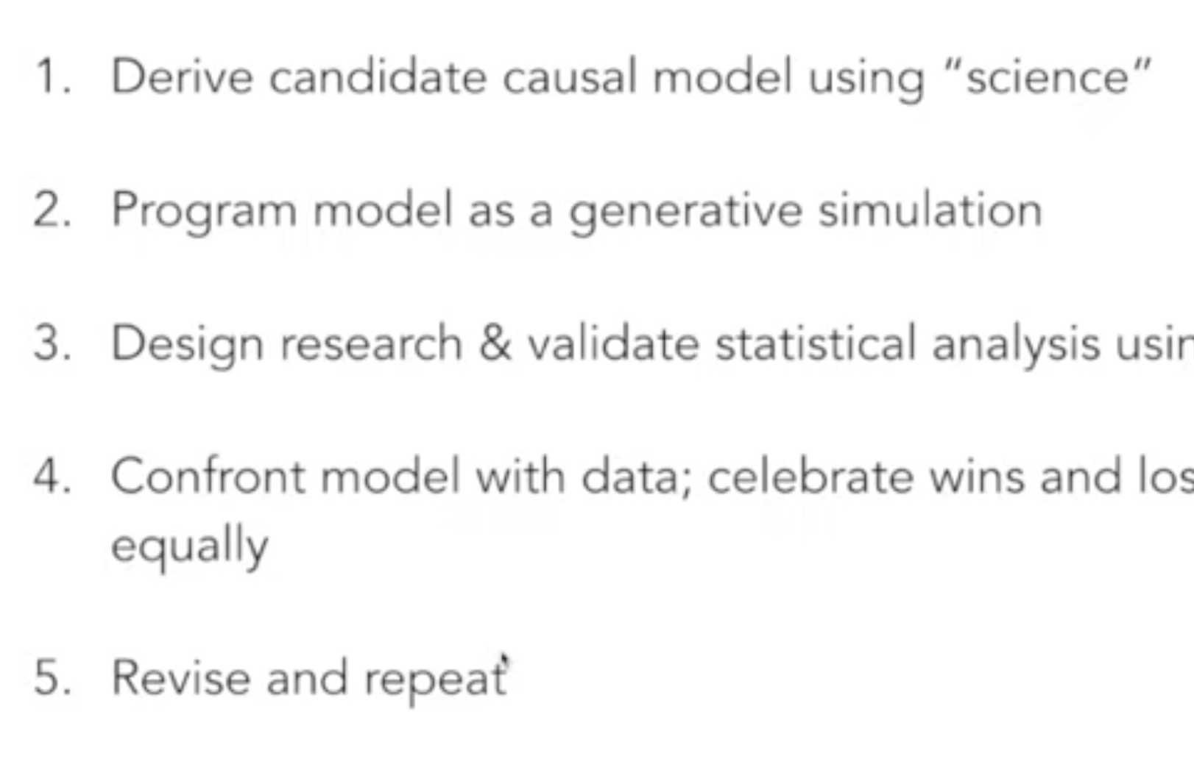
Full luxury causal workflow
Causal salad workshop (R. McElreath, 2021) (this and the two following slides) https://youtu.be/KNPYUVmY3NM

Slide 21
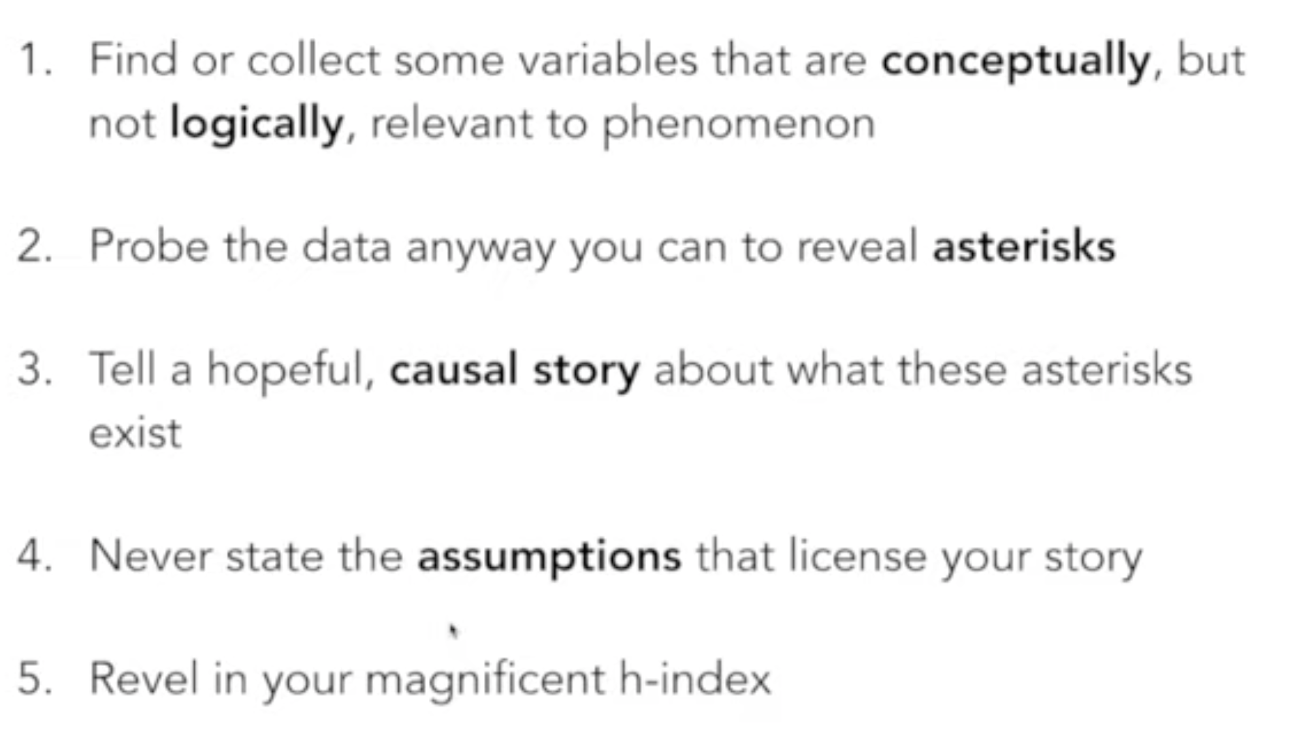
Or how it’s done in SE today

Slide 22
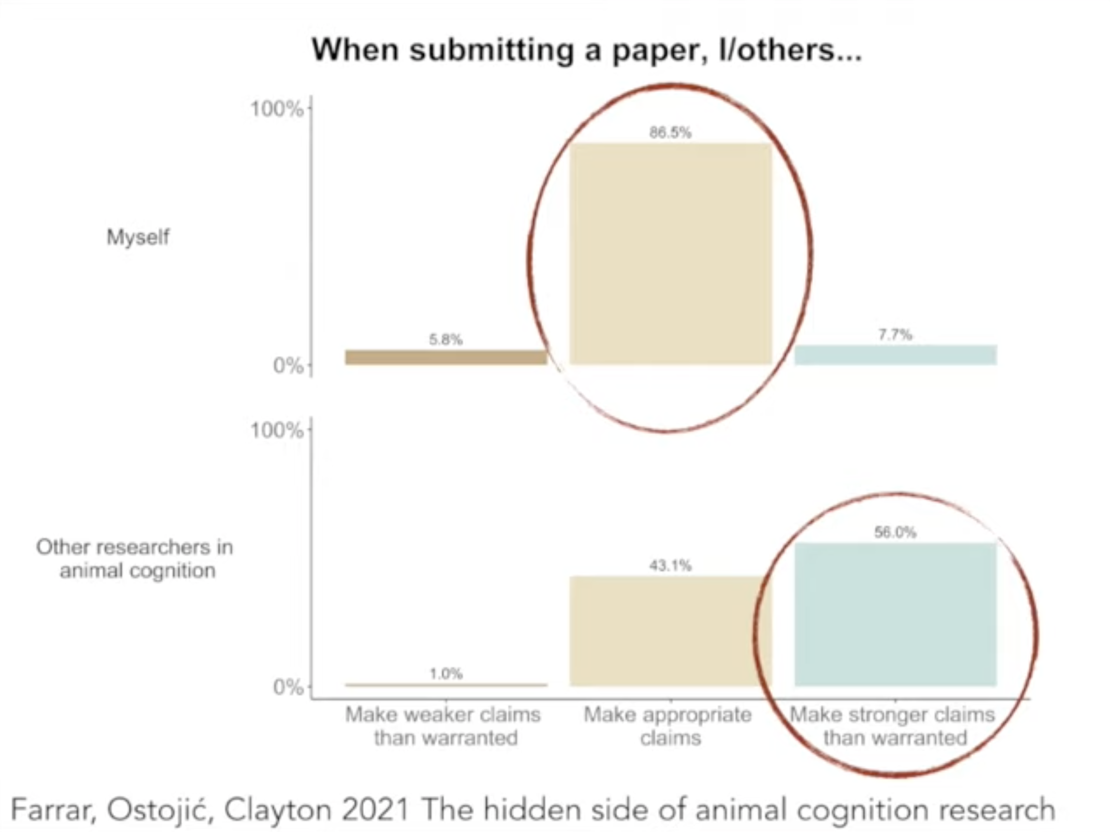
Or are we different?

Slide 23
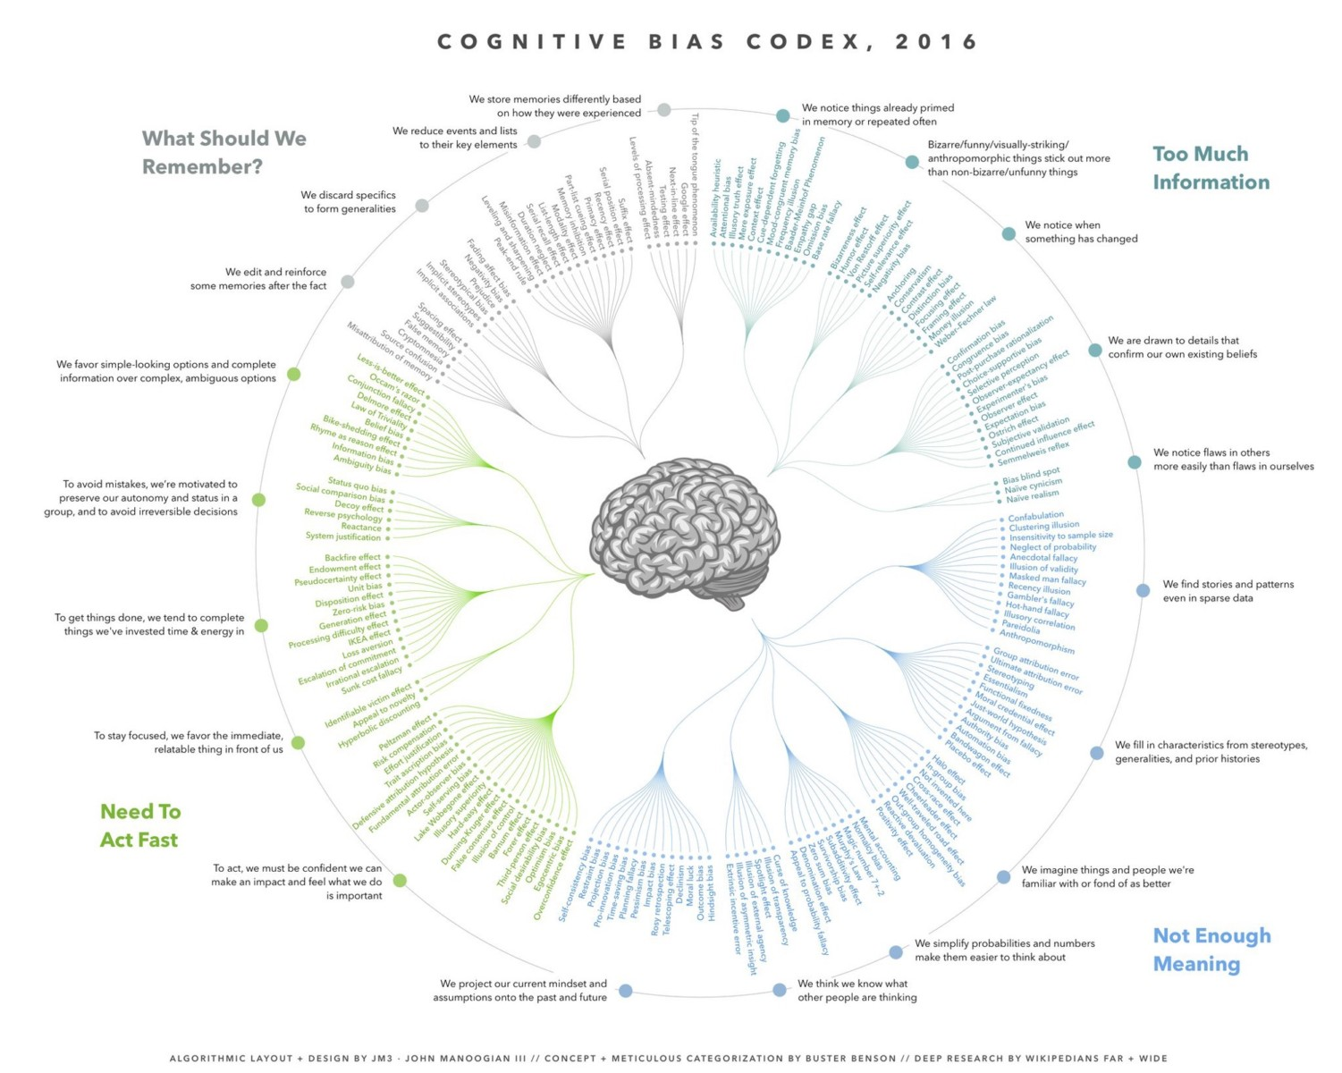
Many threats exist often connected to biases

Slide 24
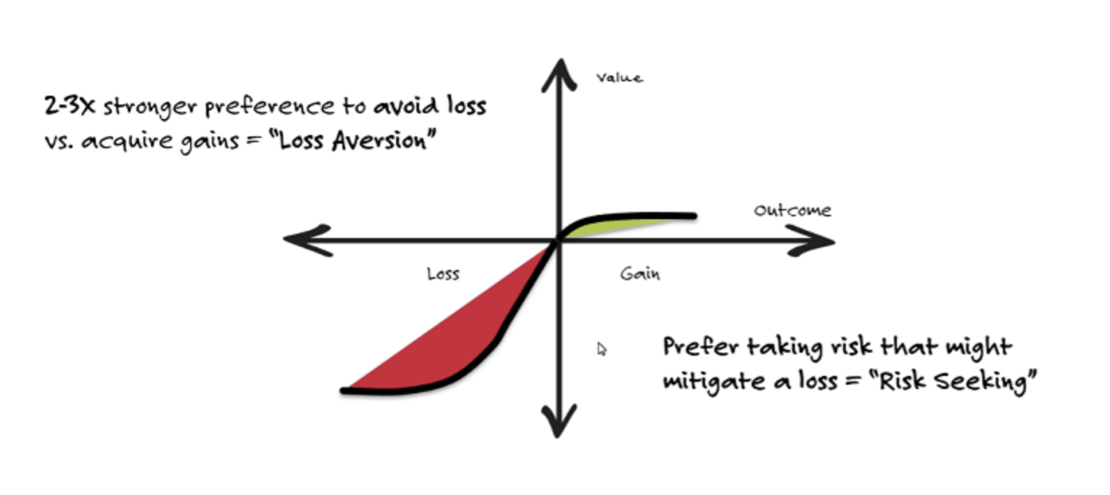
Kahneman & Tversky (1979)

Slide 25
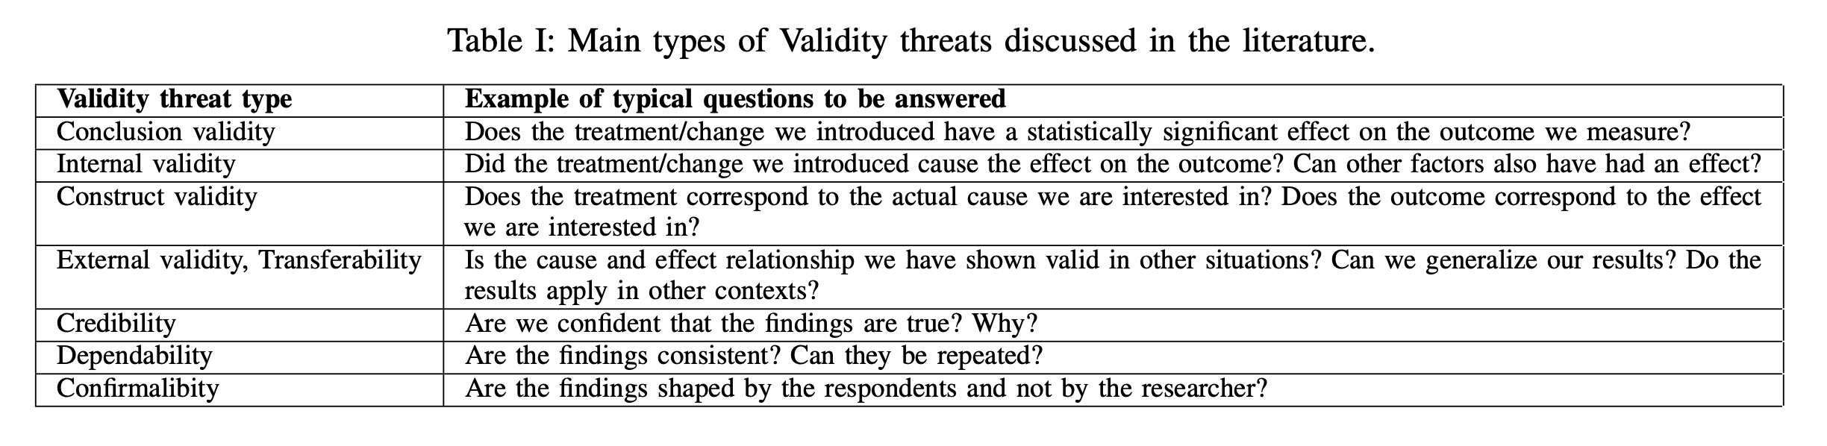
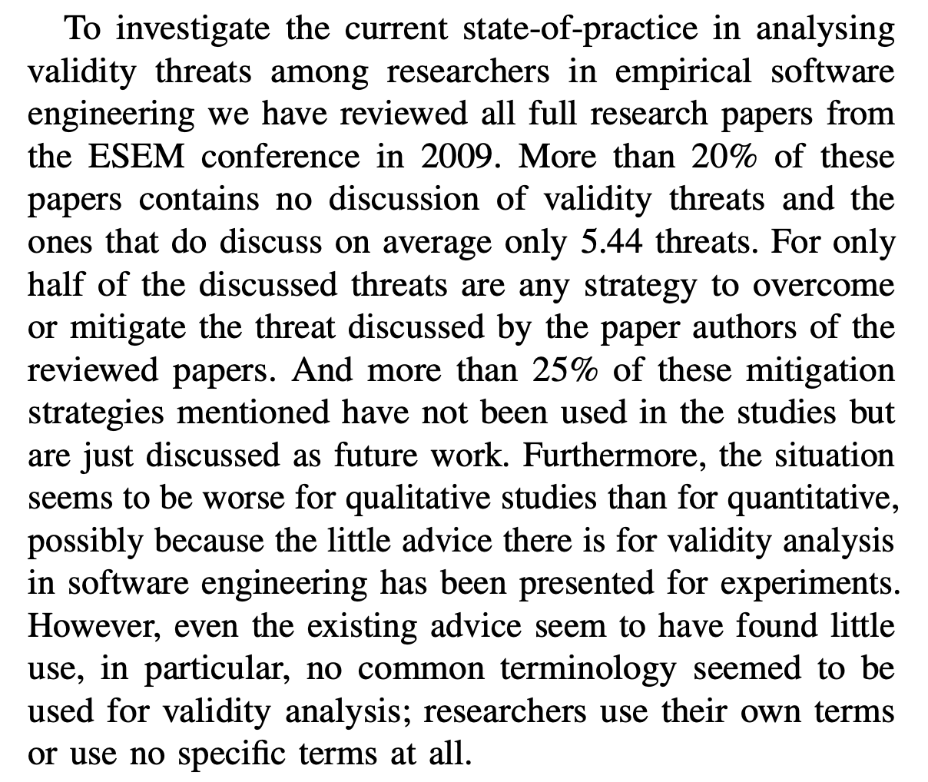
Feldt & Magazinius (2010)

Slide 26
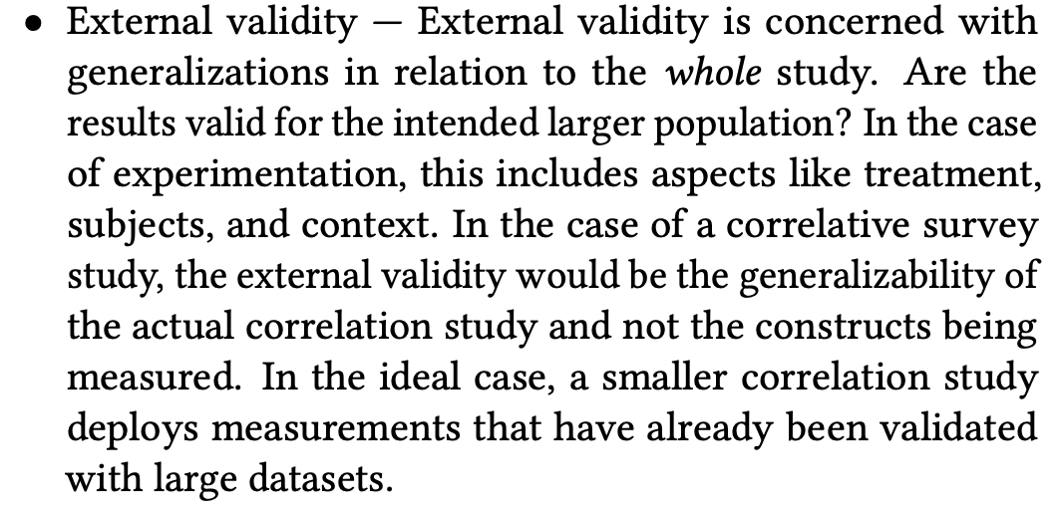
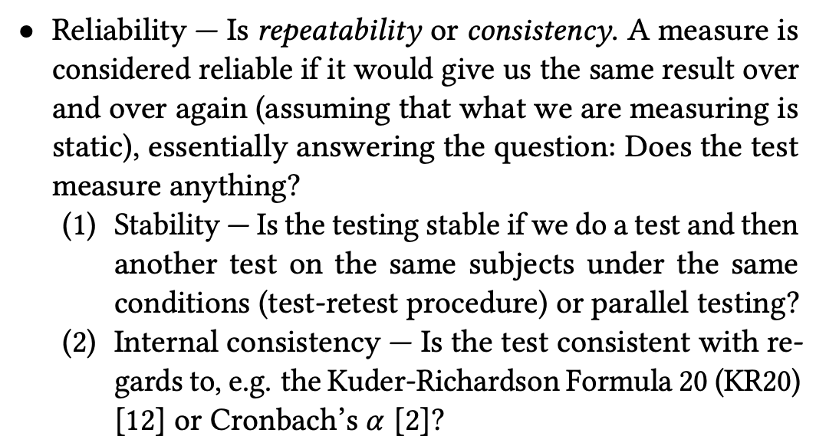
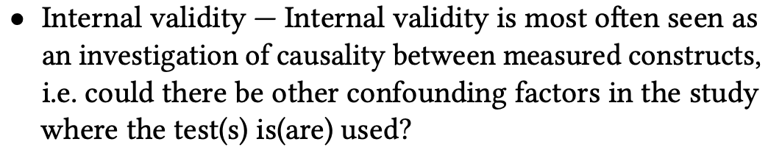
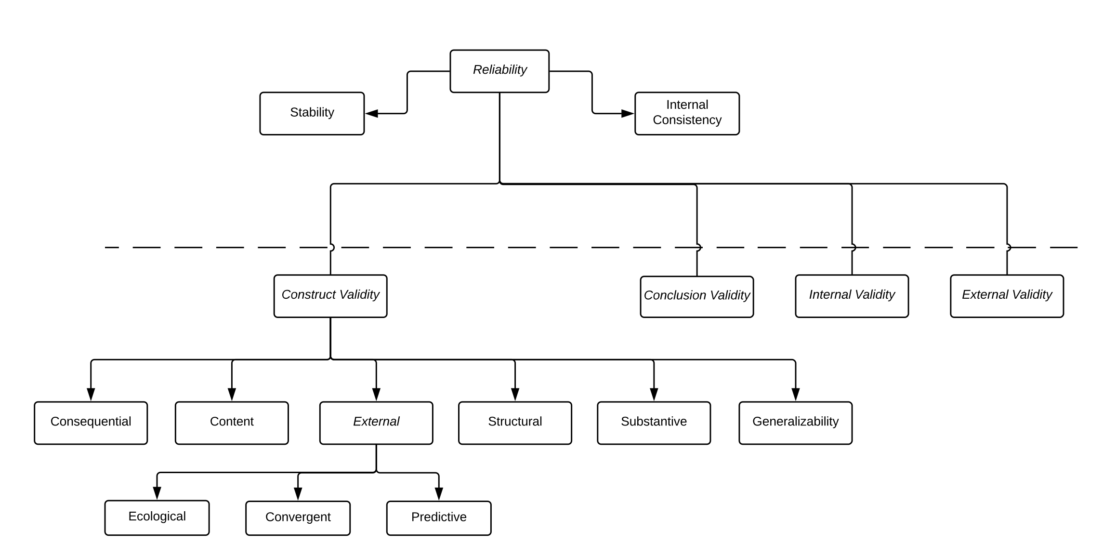
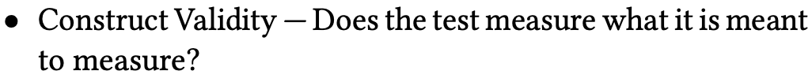
Gren (2018)

Slide 27
References
Gren, L. 2018. ”Standards of validity and the validity of standards in behavioral software engineering research: The perspective of psychological test theory”, In Proceedings of the 12th ACM/IEEE International Symposium on Empirical Software Engineering and Measurement (ESEM '18). ACM, New York, NY, USA, Article 55, DOI:10.1145/3239235.3267437
Feldt, R. & Magazinius, A. 2010. ”Validity Threats in Empirical Software Engineering Research - An Initial Survey”, In Proceedings of the 22nd International Conference on Software Engineering & Knowledge Engineering (SEKE'2010), pp. 374-379, San Francisco, CA, USA
Kahneman, D. & Tversky, A., 1979. Prospect Theory: An Analysis of Decision under Risk. Econometrica, Econometric Society, vol. 47(2), pages 263-291, March https://ideas.repec.org/a/ecm/emetrp/v47y1979i2p263-91.html
Cognitive bias codex. https://www.designhacks.co/products/cognitive-bias-codex-poster

